Slide 1
Case-Study 2
Francisco Marcó
Sava Vasilev
Kaloyan Andreev

Slide 2
Our Team
Group 10
Francisco Marco
f.marco@student.fontys.nlhttps://git.fhict.nl/I480437
Kaloyan Andreev
k.andreev@student.fontys.nlhttps://git.fhict.nl/I476236
Sava Vasilev
s.vasilev@student.fontys.nlhttps://git.fhict.nl/I495166

Slide 3
Agenda
Idea Pitch
Project Definition
Technical Specifications
Demo
Conclusion

Slide 4
Idea Pitch

Slide 5
Background
Our clients for this project are companies that are looking to securely store their media files in a remote server. We propose to deliver an easy-to-use application which ,when used with our servers, will provide a flexible, simple, and effective media storage management experience. Our aim is to reduce storage costs for companies, while fulfilling any security expectations they may have.
The project aims to develop and provide an IT SaaS, able to store and manage files for large-scale media companies. The software manages the files stored in a remote server (managed by us), which then can be viewed and organized in a web application.

Slide 6
Project Definition

Slide 7
Goals
Functional Requirements
Non-functional Requirements
Upload, Delete and send files to other users in the network.
Manage and view the files using the web application.
Reduce storage costs by storing all the files remotely.
Synchronize files between the server and a local machine.
Security: By use of SyncThing and other security protocols we ensure that the data is always kept safe and is compliant to various guidelines (GDPR, CIA, and more).
Scalability: Quickly scale operations by easily adding more users, managing files divided by folders called [Workspaces].
Usability: By click of a button, and an easy-to-use GUI, the User can manage their files and synchronize it real-time with the server.
Portability: Our solution is platform-agnostic, meaning it will run on any platform the user desires (as long as it’s connected to our network).

Slide 8
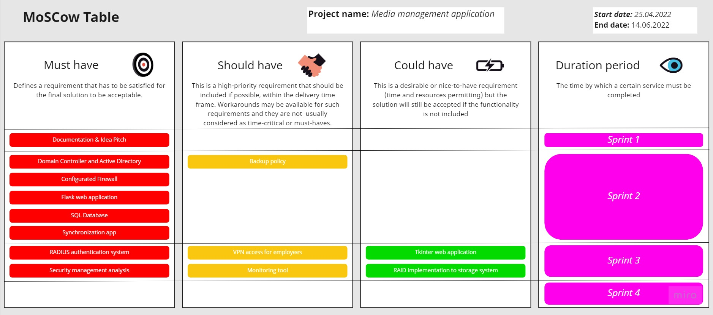
MoSCoW

Slide 9
Professional Agreements
Weekly meetings with Project tutor
Agenda elaboration
Roles in every meeting, rotating per member and per meeting
2 / 3 times a week internal team meetings

Slide 10
Technical specifications

Slide 11
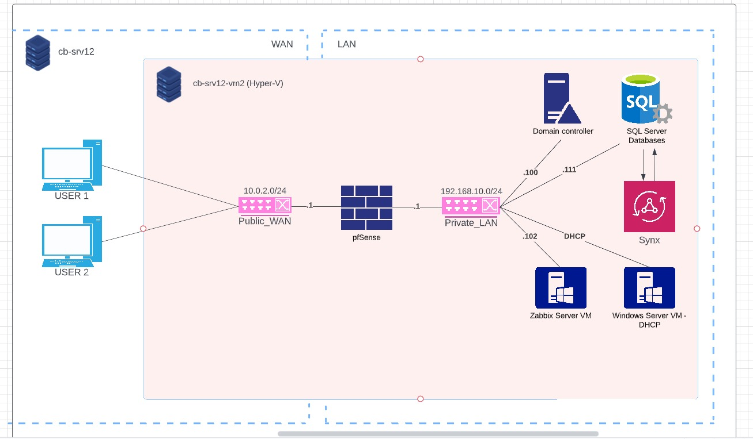
Network Diagram

Slide 12





System setup
Firewall
OS: pfSense
Services: DHCP
Zabbix
OS: Ubuntu 22.04 LTS
Services: Zabbix
File server
OS: Windows Server 2019
Services: SQL Server, Flask Web App
AD DC
OS: Windows Server 2019
User PC
OS: Windows 10

Slide 13
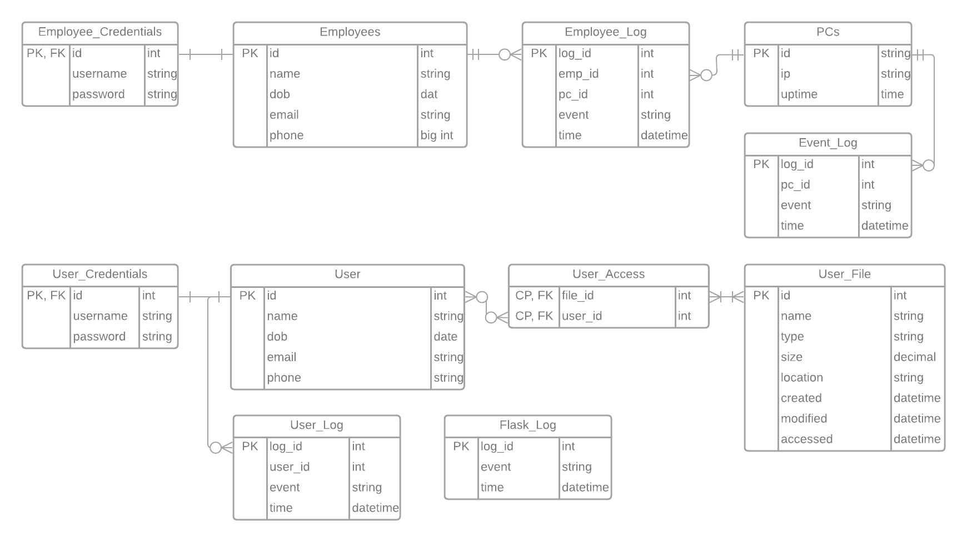
Database

Slide 14
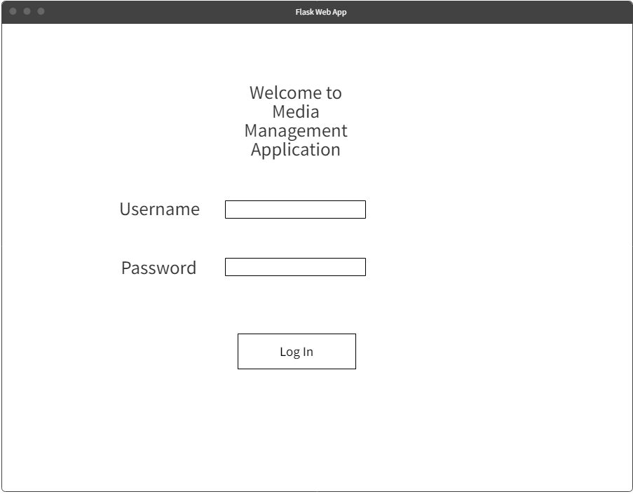
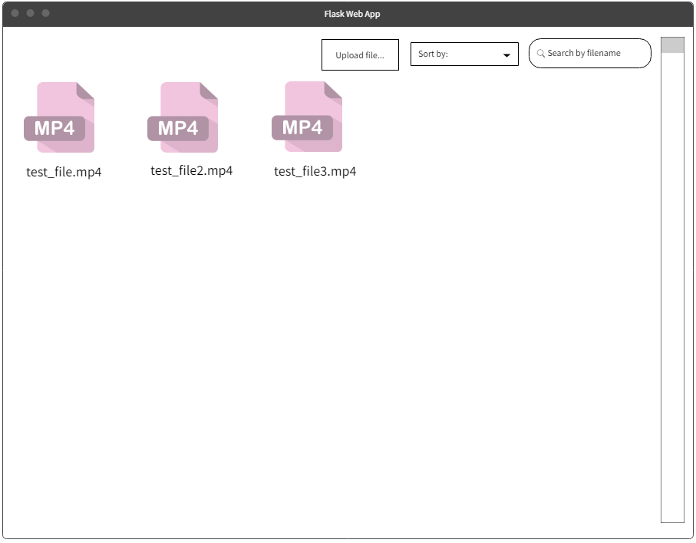
Flask web application
Login page
Main page

Slide 15
Demo

Slide 16
Conclusion

